Slide 1
Kiwanis Youth Protection Training
Finger Lakes Division Clubs
July 15, 2020

Slide 2
Why Youth Protection Matters
Kiwanis serves over 335, 000 youth each year.
Globally, 1 in 4 youth will suffer some type of abuse or maltreatment - World Health Organization
85% of child abuse victims never report their abuse
Abuse is usually at the hands of a known acquaintance and family members NOT strangers
More than 90% of abusers are people children know, love and trust
Notes:
Purpose: Why do we need this training?
Kiwanis is committed to maintaining policies and procedures that create safe places for all Kiwanis members and the youth that we serve.
Almost all Kiwanis clubs sponsor an SLP club and/or do projects with youth. There are more than 300,000 members of the Kiwanis youth programs that Kiwanians sponsor and interact with.
When we work with and mentor youth during projects and activities, their care and welfare are being entrusted to us. Parents, guardians, community members and these young people trust that our programs and events are a safe place for them.

Slide 3
Why Youth Protection Matters
Globally $7 trillion is lost due to violence against children each year, equivalent to 8% of global GDP - World Health Organization
Child abuse and maltreatment are now considered a critical public health crisis by the Centers for Disease Control
  The total lifetime economic burden resulting from new cases of fatal and nonfatal child maltreatment in the United States is approximately $124 billion.

Slide 4
Why Youth Protection Matters
Suicide is the 2nd leading cause of death in children and adolescents in the US
Suicide is the 2nd leading cause of death in 15-29 age group globally.

Slide 5
Why Youth Protection Matters
Risk Factors of suicide
  exposure to violence
  impulsivity
  aggressive or disruptive behavior
  access to firearms
  bullying
  feeling of hopelessness or helplessness
  acute loss or rejection

Slide 6
Why this training?
Protect, educate and engage all Kiwanis members
Protect youth members from predators
Empower and educate adult members with best practices when working with youth
Provide youth with positive skills development tools designed to inspire and engage our future leaders to be their best.
Notes:
Why this training?
Finally, Kiwanians in particular have good reason to act with the highest standards. If we want to be the premier provider of youth service clubs and programs, we need to hold ourselves and our fellow members to the highest standards of conduct and awareness.
And then there’s the best reason of all: It’s the right thing to do.

Slide 7
Education
Clubs must educate members annually.
Districts will have forums or workshops at conventions and conferences.

Slide 8
Youth Protection Guidelines
Background checks
• ALL Kiwanis members who work with youth in our youth clubs and programs MUST have a clear background check.
• Checks are good for 2 years.
• Encouraged for all Kiwanians working or serving with Kiwanis youth.

Slide 9
Youth Protection Guidelines
Chaperones and overnight events
• Chaperones must be 21 years old or older.
• Each overnight Kiwanis-sponsored youth event must have a minimum 1 adult chaperone per 10 students. (One adult male for each 10 youth males or part of 10 youth males, and one adult female for each 10 youth females or part of 10 youth females.)
• Adults MAY NOT share sleeping quarters with students unless it is their child or in a bunkhouse/camp cabin setting

Slide 10
Youth Protection Guidelines
Medication Only allowed with written permission from parent or guardian.

Slide 11
Youth Protection Guidelines
Transportation best practices
• Three people in the car
• Student in the back seat/rows
• Approval from parents/guardian
• Follow local school/local law policy

Slide 12
Youth Protection Guidelines
Social media/communication best practices
• Best bet: Connect via a club page/account and not individual youth member accounts.
• Do not initiate following/friending, etc.
• Treat all social posts and interactions as public.
• Refrain from posting photos of youth on your personal social media pages.
• Avoid 1:1 emails and texts. Follow the rule of 3: Always include parents/guardians, or another adult (YPM or risk officer), etc.

Slide 13
Youth Protection Guidelines
Reporting guidelines:
If a Kiwanian observes troubling behavior involving a youth at a Kiwanis event or becomes aware of a situation that is illegal or potentially unsafe for a young person at a Kiwanis event, the Kiwanian must immediately:
  Contact the appropriate personnel on-site.
  Provide notification to law enforcement personnel as appropriate.

Slide 14
Youth Protection Guidelines
Reporting guidelines:
If the Kiwanian becomes aware of the troubling behavior after the event, they must:
  Contact leaders of the event.
  Provide notification to law enforcement personnel as appropriate.
All local, state, provincial and federal laws regarding reporting must be followed.

Slide 15
Now what?
Now that you have reviewed the policies and guideline, let’s learn how to apply the Kiwanis International Youth Protection Guidelines.

Slide 16
The guidelines
If your club sponsors an Aktion Club:
Consult the Aktion Club member guidelines, available online.
Kiwanis advisors to Aktion Clubs need an approved background check conducted & verified by Kiwanis International.
Notes:
If your club sponsors an Aktion Club:
Consult and follow the Aktion Club Member Guidelines, available online.
Kiwanis advisors to Aktion Clubs need an approved background check conducted and verified by Kiwanis International.

Slide 17
The guidelines
If your club sponsors a Circle K club:
Best practices can still apply.
CKI members fall under the same background check policies as Kiwanians.
Kiwanis advisors to CKI clubs need an approved background check conducted & verified by Kiwanis International.
Notes:
If your club sponsors a CKI Club:
While CKI members are not considered youth, best practices can still apply to Kiwanis advisors working with these clubs.
CKI members fall under the same policies as Kiwanians for background checks.
Kiwanis advisors to CKI clubs need an approved background check conducted and verified by Kiwanis International.

Slide 18
Questions?
Feel free to ask questions at this time, or feel free to email me at
pitchercam13@gmail.com

Slide 19
Thank you for your attention and participation

Slide 20
“It Takes a Villa(ge) …”

Slide 21
Mission
“Villa of Hope partners with individuals, families and communities to
Rebuild relationships;
Recover potential; and
Renew Hope for the future.”

Slide 22
Vision 2030
“We will advance human potential by transforming the social foundations of our neighbors, elevating lifelong health outcomes for our community.”

Slide 23
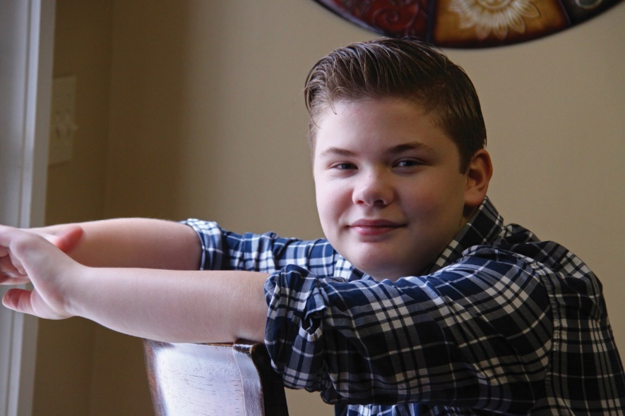
Programs & Services
Behavioral Health: Mental Health
At our Mental Health Outpatient Clinic,
our goal is to assist patients and families
with understanding and managing issues
such as PTSD, ADHD, mood disorders,
psychotic disorders, substance abuse, and disruptive disorders. We offer evaluation and treatment for children, young adults and families including individual and family treatment, medication management, group
therapy, cognitive-behavioral therapy, as
well as psychological testing.

Slide 24
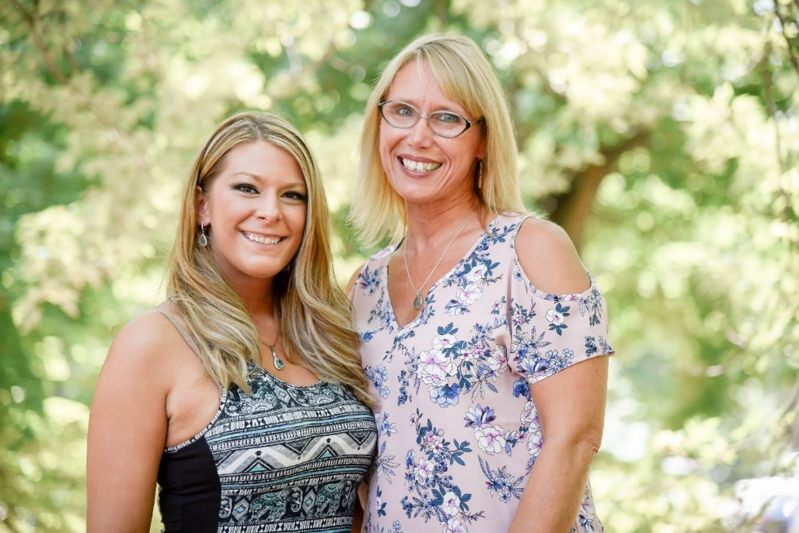
Programs & Services
Behavioral Health: Substance Use Disorder
Villa Behavioral Health services offers a
range of residential and outpatient clinic
services, for both mental health and
substance use disorders. We use evidencebased
practices that are culturally sensitive,
developmentally appropriate, and holistic.

Slide 25
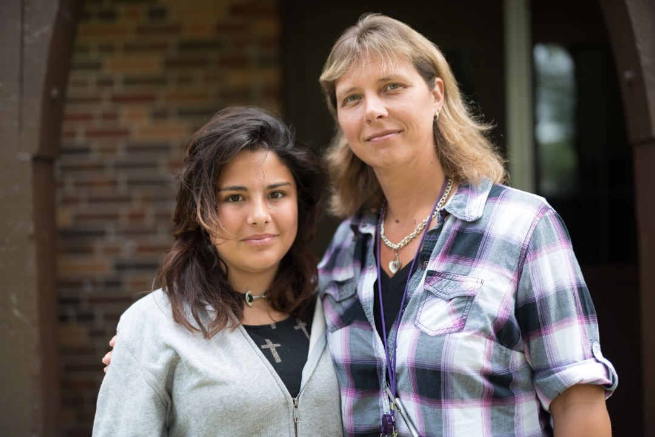
Programs & Services
Residential Treatment
When residential treatment is the best solution to care, the Villa has places to live, that support youth 24 hours
a day, 365 days per year for safety, healing and growth.

Slide 26
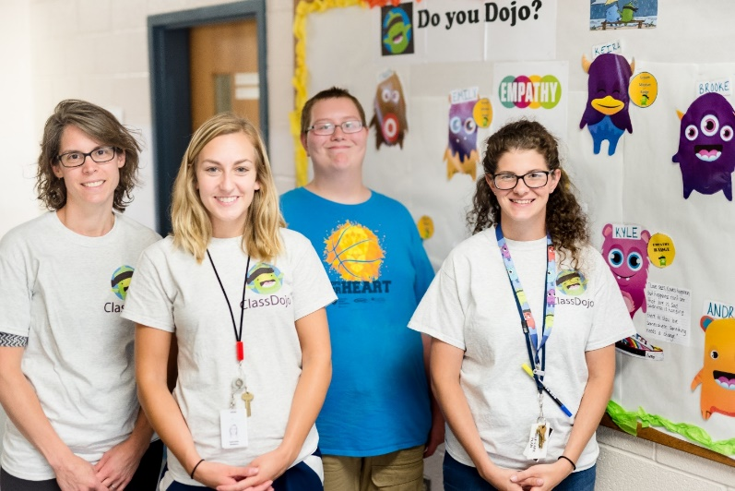
Programs & Services
Community and Residential School
Villa of Hope provides quality education
not only to youth in residential treatment
on our campus, but also to youth who
reside at home, and come in from all over
the county to our specialized day school.
Villa Schools are NYS approved private
853 schools. Our year-round programs
incorporate academic, vocational, and
remedial services for youth ages 12 to 21,
with highly trained teachers, social workers, psychologists, psychiatrists, a school nurse, a support coordinator and an academic coordinator.

Slide 27
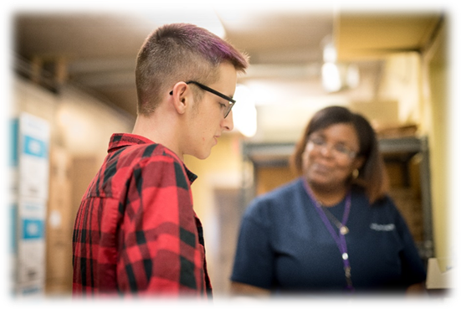
Programs & Services
WorkForce Development
The WorkForce Development program is a Villa of Hope innovation that combines comprehensive youth vocational and leadership development, designed to give our youth real-world work experience, confidence, and skills to shape responsible citizenship. The program exposes youth to career interest opportunities with job coaching and constructive feedback. Participants are paid minimum wage while in the program.

Slide 28

Programs & Services
Community Programs
Villa of Hope has a commitment to
individualized services for youth and adults; and sometimes that means services delivered
in the home and community environment.
Our newest program, Hope Place, provides a safe environment for guests to decompress and recuperate. We want to help decrease your trauma symptoms, so you can achieve stabilization and self-sufficiency. Hope Place provides you with an alternative to visiting the Emergency Room and a compassionate ear with an experienced peer.

Slide 29
Why do children need help from Villa of Hope?
ACES.

Slide 30
Adverse Childhood Experiences Study: “ACES”
A research study conducted by Kaiser Permanente and the Centers for Disease Control and Prevention 1995-1997
17,000 adults received physical exams and confidential surveys regarding childhood experiences and current health status and behaviors
Published 1998

Slide 31
What are ACES?
Personal | Parent/Guardian/ Primary Caretaker
Physical Abuse | Addiction
Verbal or Psychological Abuse | Domestic Violence
Sexual Abuse | Incarceration
Physical Neglect | Mental Illness
Emotional Neglect | Absence (divorce, death, abandoned)

Slide 32
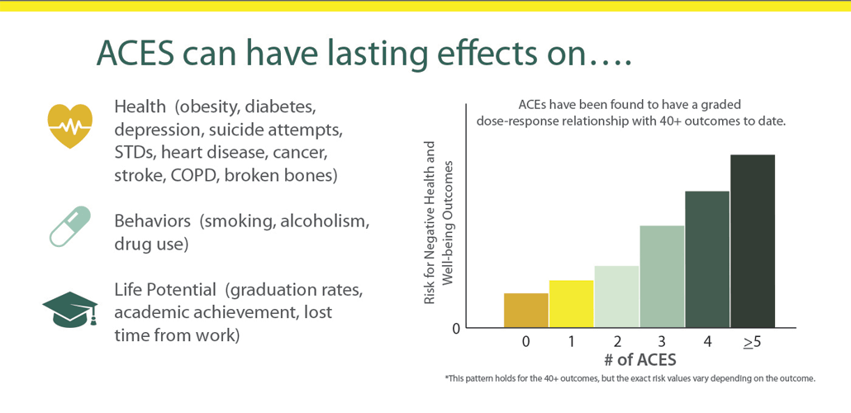

Slide 33
ACES Scoring
While you were growing up, during your first 18 years of life:
Did a parent or other adult in the household often or very often… swear at you, insult you, put you down, or humiliate you? Or act in a way that made you afraid that you might be physically hurt? If yes, enter 1:
Did a parent or other adult in the household often or very often... push, grab, slap or throw something at you? Or ever hit you so hard that you had marks or were injured? If yes, enter 1:
Did an adult or person at least 5 years older than you ever… touch or fondle you or have you touch their body in a sexual way? Or attempt or actually have oral, anal or vaginal intercourse with you?If yes, enter 1:

Slide 34
ACES’ Lifetime Effects
Participants were also asked about their life experiences as adults, and the study found an association between childhood adverse experiences and later problems with social functioning, physical health, and mental health. Those with more adverse childhood experiences reported more problems, including:
Cigarette smoking Alcoholism
IV Drug Use Chronic Depression
Attempted Suicide Teen Pregnancy
Having had more than 50 sexual partners STDs
Being Raped Experiencing Hallucinations
Serious Job Problems Premature Mortality

Slide 35
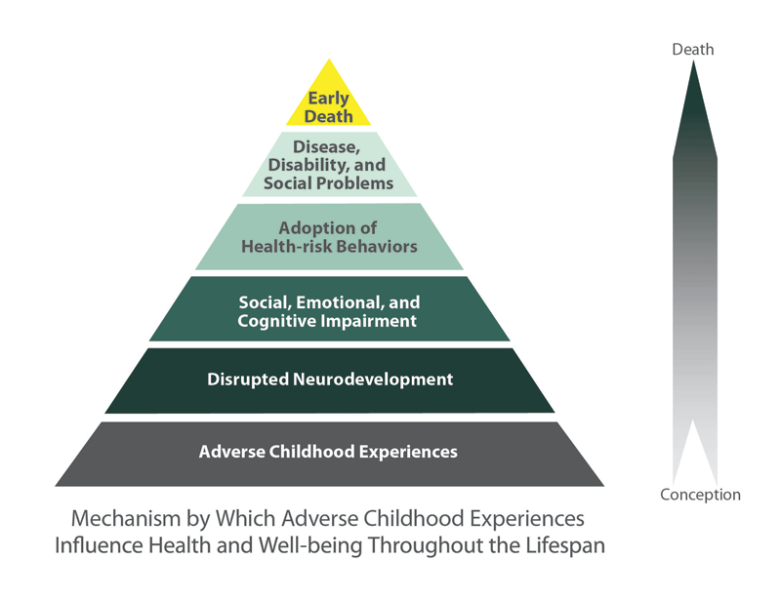

Slide 36

Adolescent Symptoms of Trauma: Pain Based Behavior

Slide 37
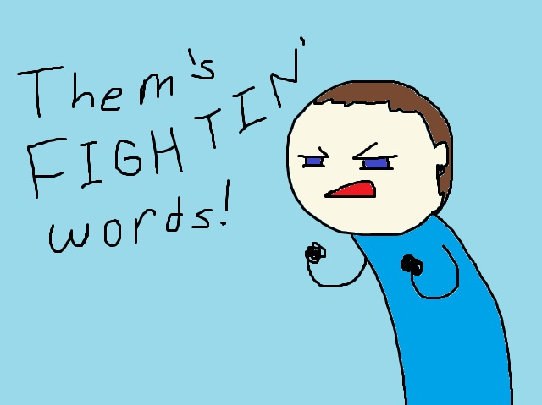

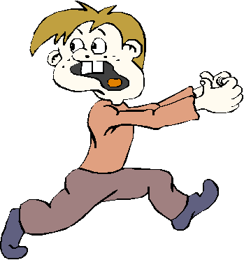
Types of Trauma

Slide 38

Trauma Definition
“Traumatization occurs when both internal and external resources are inadequate to cope with an external threat.”
  Bessel Van der Kolk, 1989

Slide 39
Brain Development
Brains are developed over time, shaped by the interaction between genetics and life experience.
Brain architecture and skills are built in a hierarchical “bottom up” sequence.
The brain has “short cuts” for “emergency messages” so the body can respond quickly.

Slide 40
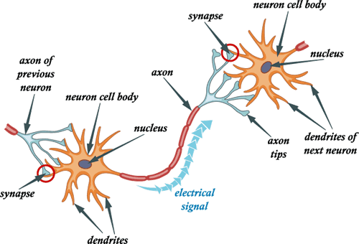
Brain Neuroplasticity
“The neurons that fire together wire together”
(in sickness and in health)

Slide 41
The Opportunities of Adolescence
Adolescence is a time of brain development second only to birth to pre-school age
Opposing perspectives can both be true
  ex: “I hate my Dad/Mom for abusing me but I still love him/her and want to go home.”
Thinking is less concrete “black-and-white” and more abstract “matter of degree”
  ex: “I didn’t get everything I wanted, but I got some of what I wanted.”
There is a positive side to adolescent “risk taking” in healing – taking a “leap of faith”

Slide 42

RESEARCH:
“Nightmares & Trauma: Life-long and Traumatic Nightmares in Veterans” (1984)
Used the Rorschach Test
to observe how people
construct meaning from a
meaningless stimulus
(ink blots).

Slide 43
FINDINGS:
Most traumatized people superimpose their trauma on everything around them
These veterans saw their trauma in the ink blots (ex: images of war)
Some traumatized people “go blank”
These veterans saw nothing in the blots – they lost their imagination and ability to make sense of their surroundings

Slide 44

What Does It Mean?
Trauma changes the brain.
We have to let go of our experiences and our assumptions.
“He/She knows better” or “He/She should be able to…” does not work.

Slide 45
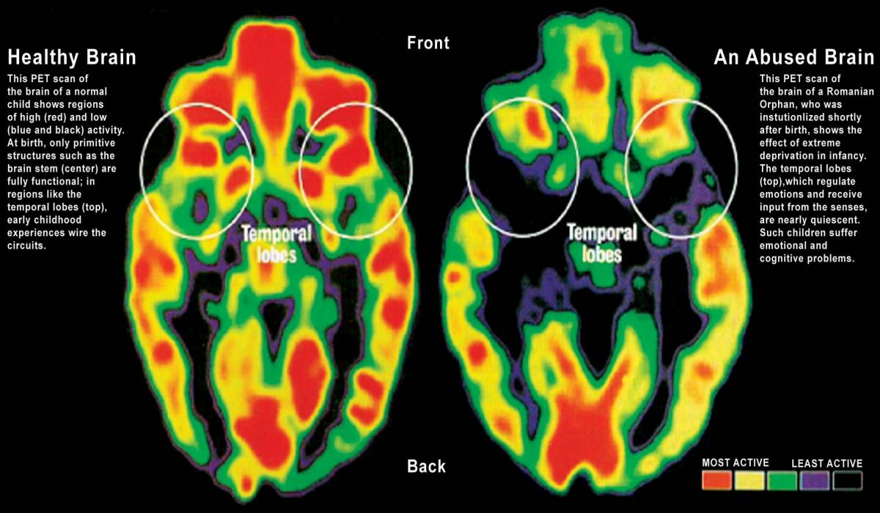
…This Is Your Brain On Trauma

Slide 46
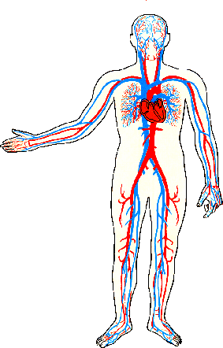
…and This Is Your Body on Trauma
“Adrenaline Rush” provides higher heart rate, energy, arousal, focus – immediate surge with short term results
Cortisol (the forgotten stress hormone) regulates blood pressure, immunity, digestion, focus – delayed onset and longer effect

Slide 47
What Does All of this Mean?
Trauma changes the brain –
AND the body!
We have to let go of our experiences and our assumptions.
“He/She knows better” or “He/She should be able to…” does not work.

Slide 48
Trauma Informed
Psycho-Education
“You can grow new neurons in the part of your brain that holds memory. First steps include a healthy diet, exercise, and cognitive (mental) exercise.”
“The thermostat for stress in your brain needs to be reset.”
“Sensations from your own body should not be cause for alarm. Don’t let your body be the boy who cried wolf.”

Slide 49
Recommendations (web based)
TED Talk by Pediatrician Nadine Burke Harris “How Childhood Trauma Affects Health Across a Lifetime”
http://traumainformedcareproject.org
www.cdc.gov/violenceprevention/acestudy
https://acestoohigh.com
www.sanctuaryweb.com
https://andruscc.org/sanctuary-institute

Slide 50
Recommendations (books)
“The Body Keeps the Score: Brain, Mind, and Body in the Healing of Trauma” by Bessel van der Kolk (2014)
“The Boy Who Was Raised as a Dog: What Traumatized Children Can Teach Us About Loss, Love, and Healing” by Bruce Perry & Maia Szalavitz (2006)
“Resilient Adults: Overcoming a Cruel Past” by Gina O’Connell Higgins (1994)

Slide 51

Questions/Discussion

